Slide 1
Plasma Diagnostic Techniques Lecture 12: Thomson scattering
Deborah O’Connell
York Plasma Institute

Slide 2
Thomson Scattering

Slide 3
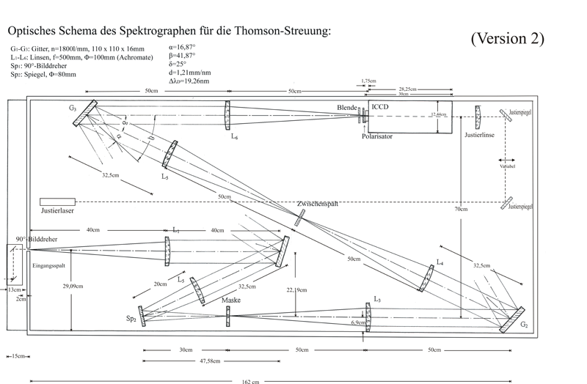
Practical challenges
Thomson scattering cross section is very small requiring high power lasers.
Stray light can be problematic, using a triple grating spectrometer can very efficiently reduce stray light.

Slide 4
Typical results
What is the x-axis?
What is the y-axis?
How does the density depend on pressure?
How does the temperature depend on pressure?

Slide 5
Typical results
What is the x-axis?
What is the y-axis?
How does the density depend on pressure?
How does the temperature depend on pressure?

Slide 7
Phase resolved optical emission spectroscopy (PROES)
- Probing high energy electrons

Slide 8
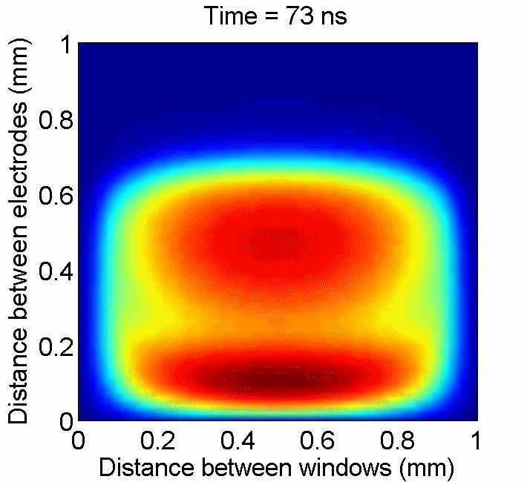
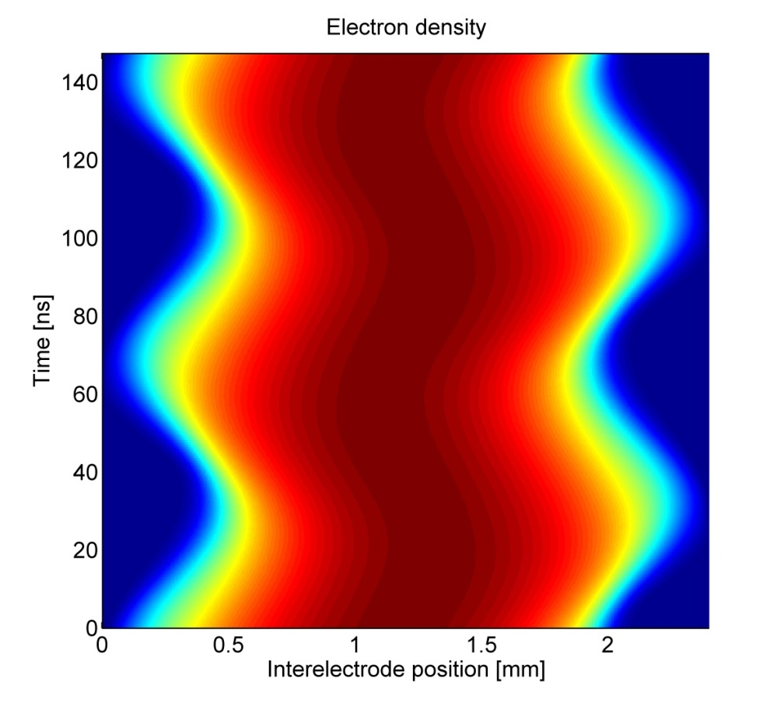
Electron dynamics in CCPs: Simulation
2-dimensional fluid simulation (electrons treated semi-kinetically)

Slide 9
Excitation/ionization structures in gamma-mode operation
Measured space & time resolved excitation structures in gamma mode (2 MHz, Neon, 64 Pa)
In gamma-mode plasma ionization & sustainment are similar to DC discharges, but time dependent.
Electrons are emitted from the surface due to ion bombardment, metastables, & UV radiation.
At phases of high sheaths potential these electrons are accelerated & develop an ionization avalanche of energetic electrons.

Slide 10
Excitation/ionization structures in alpha-mode operation
16 Pa: gamma- & alpha-mode
At lower pressure or powers, disfavouring ionization avalanches, additional ionization processes become obvious – sheath expansion heating.
With further reduction of pressure or power this sheath expansions mechanism becomes dominat.
Sheath expansion heating is governed by the velocity of the sheath pushing electrons into the higher density region of the plasma bulk.
Sheath expansion heating becomes more dominat with higher frequencies when similar velocities are generated at lower sheath voltages.
8 Pa: ‘pure’ alpha-mode

Slide 11
Dual-frequency plasma: 2 MHz & 14 MHz
D. O'Connell, T. Gans, E. Semmler, P. Awakowicz, Appl. Phys. Lett. 93, 081502 (2008)

Slide 12
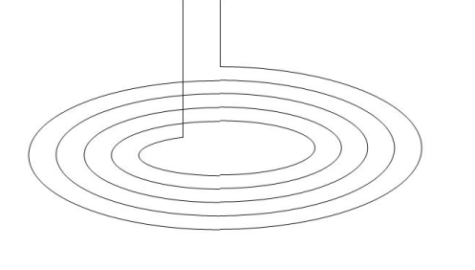
Concepts of rf plasmas
Capacitive coupling
Inductive coupling
RF
RF
Electrode
Sheath
Plasma
E-field
rf voltage applied to an electrode
Sheath dynamics controls plasma
2(+) operation modes: alpha, gamma
Coil driven with rf current
Time varying B-field induces E-field
Induced E-field controls plasma
Operation modes: E-mode, H-mode

Slide 13
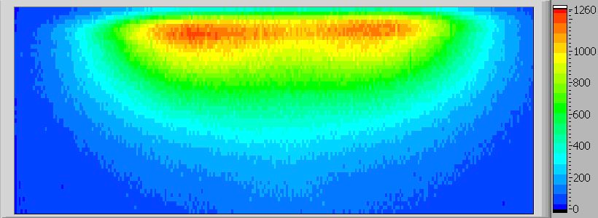
Inductively coupled plasmas (ICP)
Coil driven with rf current.
Time varying B-field induces E-field.
Operation modes: E-mode, H-mode
In E-mode the plasma is determined by the voltage drop along the coil – similar to CCPs.
In H-mode the plasma is controlled through the induced E-field.
The plasma density in H-mode is typically an order of magnitude larger.
Combination of ICP & CCP biased substrates provides separate control of plasma characteristics & sheath characteristics – in particular ion flux & ion energy.
RF
E-field

Slide 14
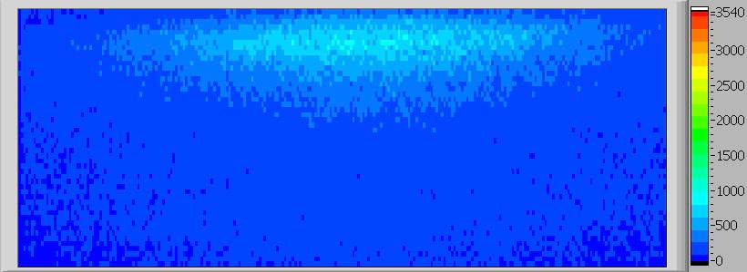
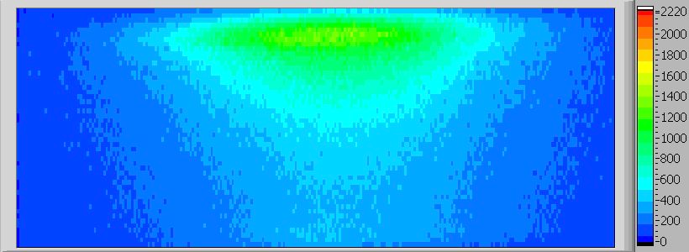
Ionization dynamics in E-H transition
CCP-α-mode:
Sustainment: sheath dynamics
CCP-γ-mode:
Sustainment:
avalanche of
secondary electrons
ICP-mode:
Sustainment:
induced electric field
along torus

